Slide 1
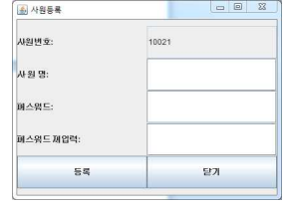
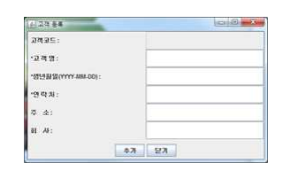
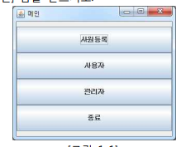
public class rhroremdfhr extends JFrame {
private JTextField[] textFields = new JTextField[6];
-
for (int i = 0; i < textFields.length; i++) {
panel.add(new JLabel(new String[] {"고객코드:","*고객명:","*생년월일(YYYY-MM-DD)","*연락처:","주소:","회사;"}[i]));
textFields[i]= new JTextField();
panel.add(textFields [i]);
}
JPanel panel2 = new JPanel(new FlowLayout());
add(panel2, BorderLayout.SOUTH);
JButton button = new JButton("추가");
panel2.add(button);
JButton button2 = new JButton("닫기");
panel2.add(button2);
setVisible(true);
}
}

